Slide 1
Absa Investments
Mid-Year Market Outlook
June 2023
Ricardo Smith | Actuary (FASSA), Master of Management, Finance & Investment (WBS)
Chief Investment Officer: Absa Investments

Slide 2
Houseview Expectations
01

Slide 3
2026 Bull-Bear Scenarios
 | Influential factors | Bear case | Negative surprises | Market expectations | Positive surprises | Bull case
Global trade | Geopolitical tensions, policy uncertainty and tariffs, legality of tariffs | Collapse of global trade | Further tariff increases | Higher tariffs/ trade tensions | Moderate tariff cuts | Significant tariff cuts
Global inflation | Services inflation, energy prices, shelter costs, tariffs, food prices | US inflation ticks up to above 4% | US inflation deteriorates to above 3% | US inflation expected to remain sticky around 3%, UK inflation expected to ease but remain above 2% and Eurozone inflation expected to be around 2% in 2026. | US inflation eases to below 2.5% | US inflation eases to 2% or below
US interest rates | Inflation, inflation expectations, unemployment, economic growth | Rate hikes | No cuts | 25-50 basis points in cuts this year | 75-100 basis points in cuts this year | More than 100 basis points in cuts this year
US economy | Global trade, unemployment, consumer spending, government spending, taxes | Anaemic to negative economic growth | Cooling economic growth between 1% and 2% | US economic growth of around 2.0% this year | US economic growth significantly above 2% | US economic growth above 3.0%
China economy | Property, construction and manufacturing sectors, global trade, consumer spending, policy uncertainty | Growth below 4% | Growth significantly below 5% | China economic growth of around 5% | Economic growth higher than 5% | Economic growth above 6%
SA economy | Global trade, commodity prices, logistics, infrastructure, business and consumer confidence & spending, unemployment, attraction and allocation of capital | Recession | Growth below 1% | SA economic growth above 1% | Growth around 2% | Growth above 3%
Global market | Earnings, margins, valuations, capital expenditure, AI, interest rate cycle, risk sentiments, consumer spending | Negative earnings growth | Low single-digit growth | High positive single-digit to double-digit growth in earnings over the next 12 months, led by the US with Europe and the UK lagging | Positive revisions in growth trajectory | Prolonged bull market
Local market | Earnings, margins, valuations, commodity prices, risk sentiments, structural reforms, consumer spending | Aggressive market drawdowns, negative earnings growth | Pullback in precious metal prices, distressed local consumer, high input costs lead to low single-digit growth | High positive single-digit to double-digit growth in earnings over the next 12 months | Positive revisions in growth trajectory | Prolonged broad-based bull market across resources, financials and industrials
Source: Absa Investments, Bloomberg, May 2026
Note: Market expectations are as at the start of the year. The black outline is what has played out throughout the year and/or how market expectations have shifted. The red blocks represent our baseline expectations

Slide 4
US-Iran Conflict
02

Slide 5

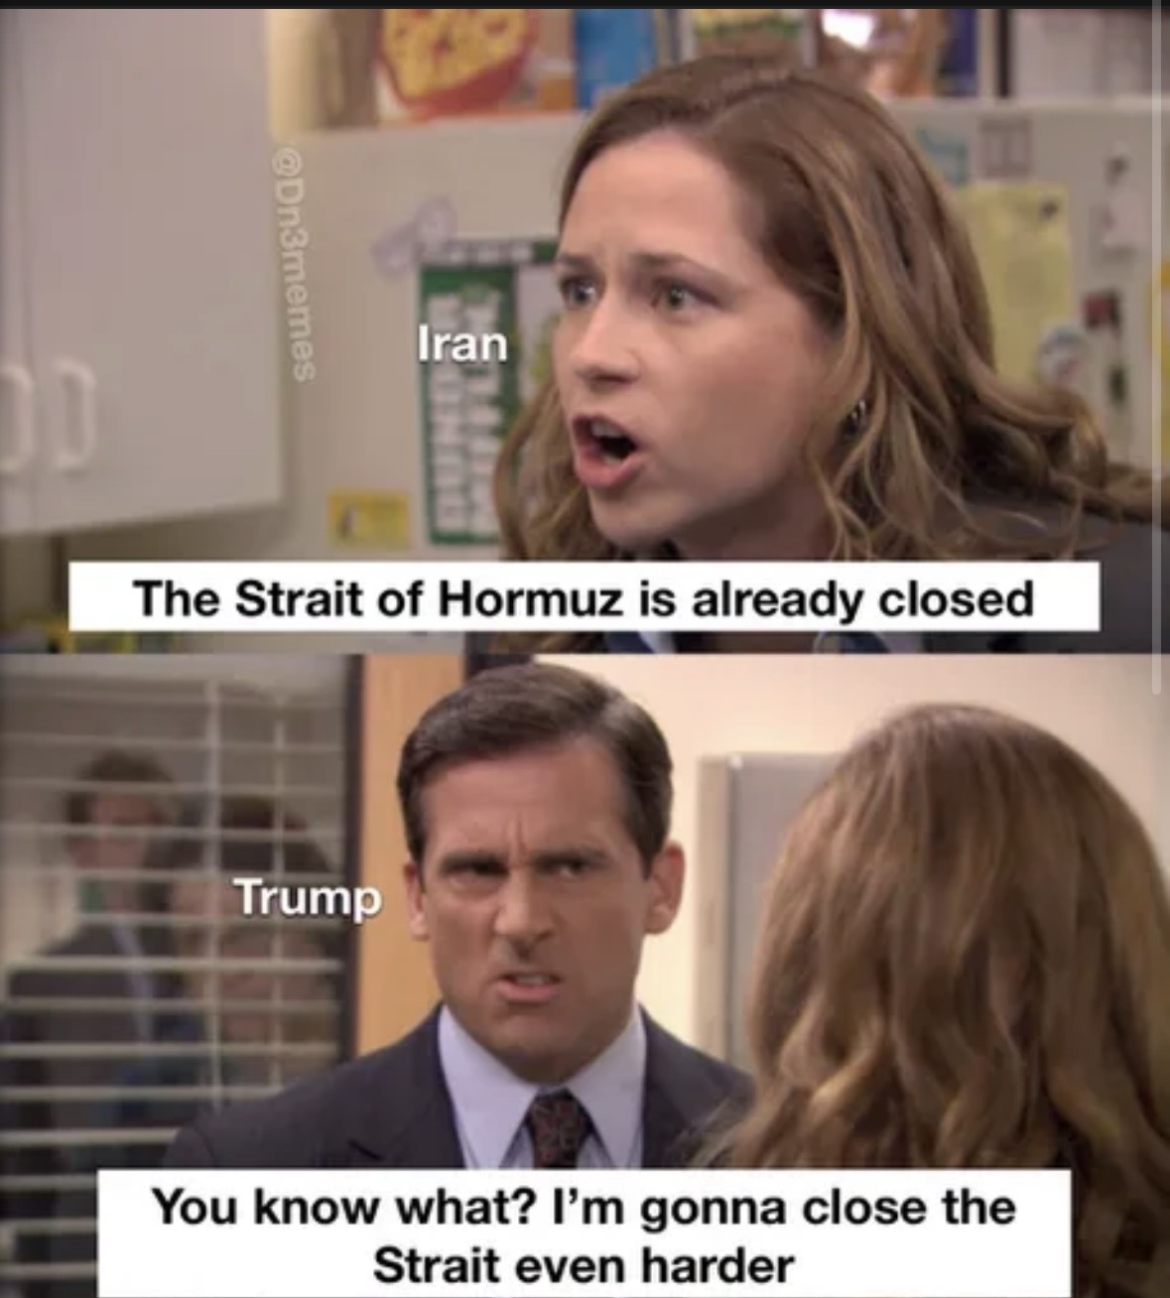
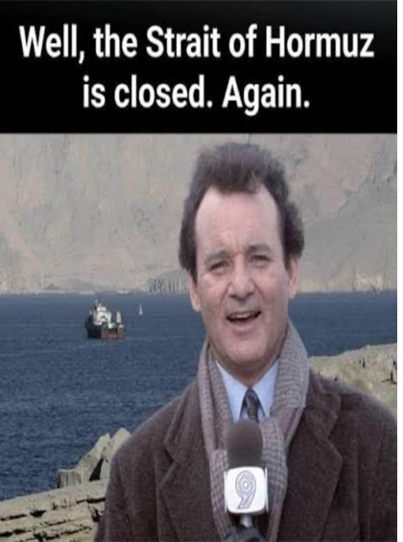

What’s been happening?

Slide 6
How We Got Here — and Why Markets Care
28 Feb - Conflict begins
War breaks out between the US and Iran, with rapid escalation across the Middle East.
Market impact
Sharp rise in geopolitical risk.
Global markets shift to a risk‑off stance.
Oil prices turn volatile immediately.
Early March - Energy risk takes centre
Growing threats to shipping and energy infrastructure.
Attention shifts to the Strait of Hormuz, a critical global energy chokepoint.
Market Impact
Oil prices rise as markets price supply risk.
Inflation concerns begin to re‑emerge globally.
Defensive positioning increases across asset classes.
Mid‑March - Disruption becomes explicit
Shipping through the Strait of Hormuz is severely constrained.
Commercial vessels are hit; insurers raise war‑risk premia; major shipping lines avoid transit.
Market impact
Brent crude remains volatile, hovering above $100/ barrel
Markets reprice from “event risk” to duration risk.
Central banks grow more cautious.
Policy Response
IEA coordinates a release of strategic oil reserves to stabilize markets.
Temporary relief in oil markets.
Volatility remains elevated.
Late March - Macro implications widen
Focus shifts to second‑round effects: inflation, growth, and policy trade‑offs
Market Impact
Inflation expectations move higher.
Rate‑cut expectations are pushed out globally.
Bonds offer less diversification than usual.
Early April - Temporary de‑escalation
A conditional two‑week ceasefire is announced, linked to reopening shipping routes
Mid–Late April - Fragility returns
Ceasefire proves fragile; escalation risks persist.
Underlying geopolitical tensions remain unresolved
June- US Iran Peace deal
The United States and Iran announced that they have reached a peace deal
Reopening of the Strait of Homuz
Oil Prices fall

Slide 7
Global & Local Economy
03

Slide 8
Global Oil Scenarios – Geopolitical Risks
 | Bear case (severe escalation, prolonged war with material impact on supply) | Base case (conflict contained and no sustained supply shock) | Bull case (rapid de-escalation and no material supply shock)
Oil prices | Significant supply chain and production disruption. Oil prices sustained above $100 | Temporary spike in oil prices, with subsequent recovery when supply normalizes | Prices rapidly revert to normalized levels
Global inflation | Resurgent inflation on the back of higher energy prices and fuel costs | Short-lived inflation uptick followed by subsequent normalization | No material impact, global inflation continues to trend lower
Global interest rates | Global central banks hike rates aggressively, rates stay higher for longer | Rate cuts potentially pushed out further or some early hikes to curb second round effects | No change in monetary policy pathway, projections for further cuts remains intact
Economic growth | Slower economic growth across the globe, with large oil importers (China/ Europe) seeing the largest impact | Modest, short-term impact on growth | Growth expectations recover as uncertainty dissipates
Markets | Risk-off sentiments trigger selloff in equities, energy and defense sectors outperform. Emerging markets under perform. | Markets remain volatile as oil prices recover, but start to see broad based market recovery | As geopolitical risks fade, equity markets rebound, rotation back into longer duration sectors
Source: Absa Investments, May 2026

Slide 9
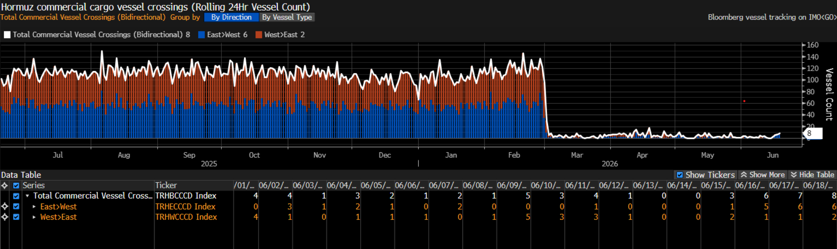
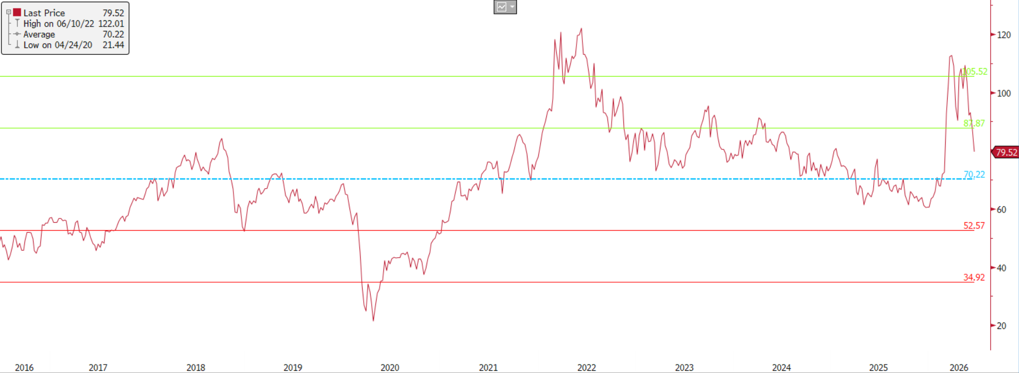
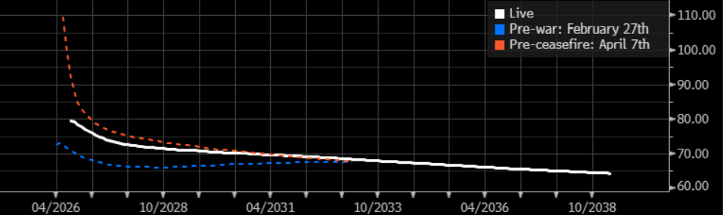
Global Oil
Hormuz commercial vessel crossing
Brent crude price
Brent crude forward price curve
Source: LSEG, 04 June 2026
Source: Bloomberg, 18 June 2026
Brent crude prices remain volatile, continuing to hover above the $100/barrel mark. Although futures markets are pricing in a relatively short-lived shock and subsequent normalization, this is not fully reflective of the perceived impact should the war be prolonged.
Source: Bloomberg, June 2026

Slide 10
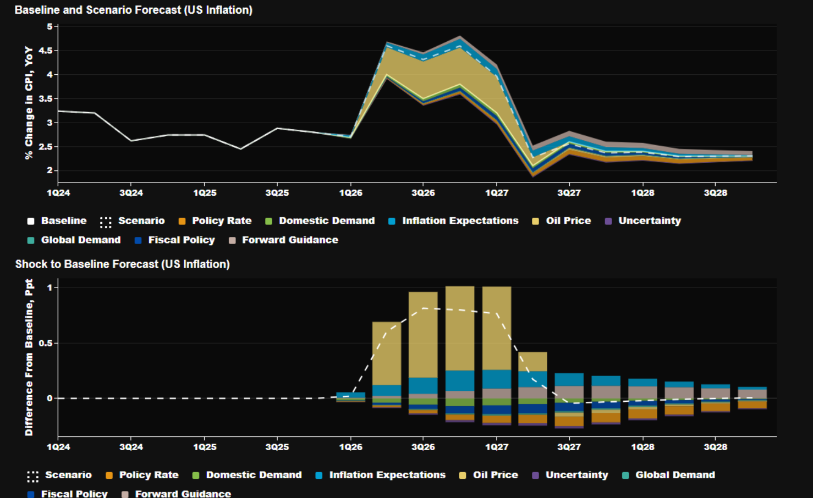
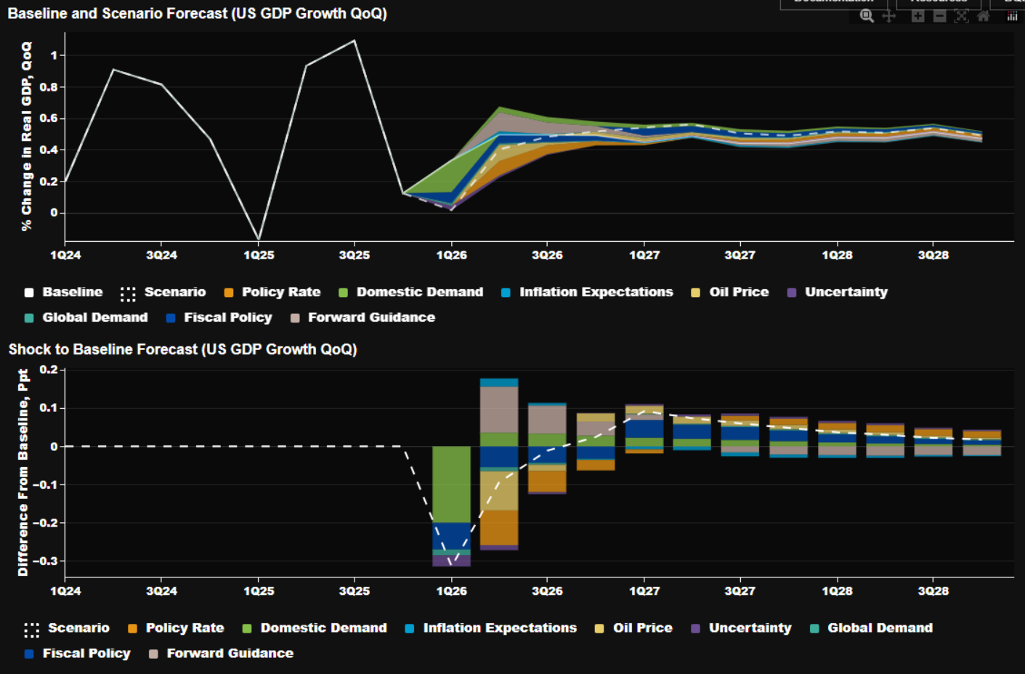
Oil Shock on US – Short- to Medium Term Effect
$40/barrel oil shock, is about 100 bps inflationary
$40/barrel oil shock, is about -30bps recessionary
Source: Bloomberg, 30 April 2026
Source: Bloomberg, 30 April 2026

Slide 11
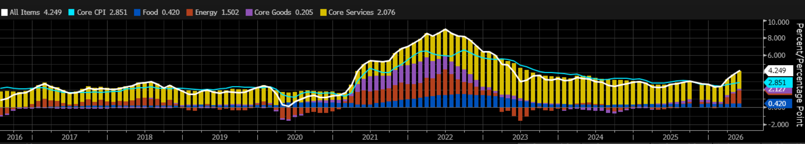
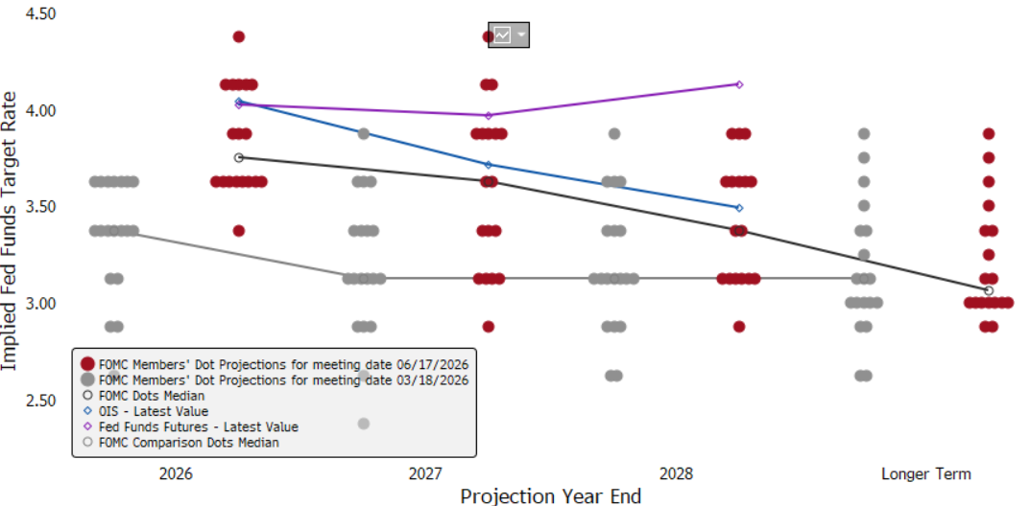
US interest rates
US inflation
US Fed member expectations
Source: Bloomberg, 18 June 2026
Source: Bloomberg, 18 June 2026

Slide 12
SA 10-year Yield Dissection
SARB Headline inflation forecast
10-year yield dissection
Forward rate agreement markets
Source: LSEG, Absa Investments, 03 June 2026
Source: Bloomberg, Absa Investments, 28 May 2026
Source: LSEG, Absa Investments, 12 June 2026

Slide 13
SA fiscus – debt containment
Primary and consolidate budget balance projections
Debt-to-GDP trajectory
  Expenditure items
Source: National Treasury, Absa Investments, 29 January 2026

Slide 14
Yield Curve
Yield curve movements
Forward yield curve
Source: Bloomberg, Absa Investments, 11 June 2026

Slide 15
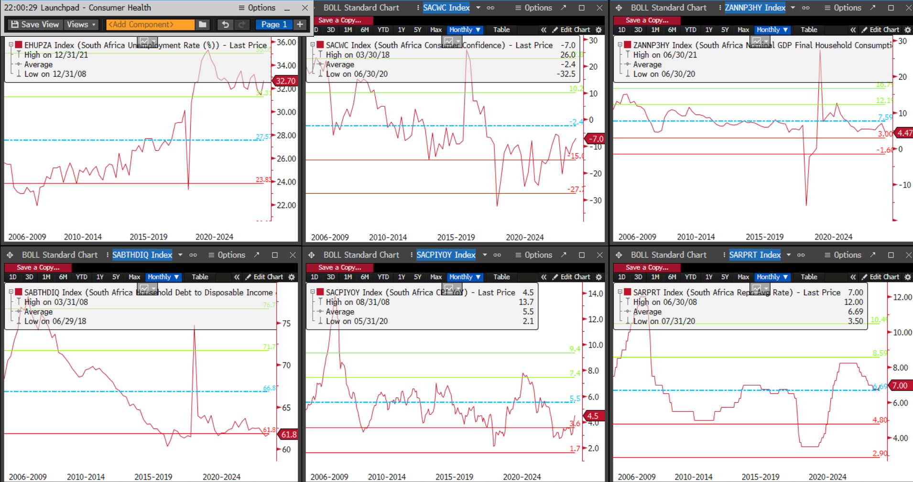
Consumer Health
Source: Bloomberg, 18 June 2026

Slide 16
Agriculture
04

Slide 17
Agriculture in the South African Economy
GDP growth by sector over the past 20 years
Source: Statistics South Africa (Stats SA), Absa Investments, April 2026

Slide 18
Agriculture in the South African Economy
SA Q4 2025 GDP breakdown by sector
SA Q4 2025 employment by Sector
Source: Statistics South Africa (Stats SA), Absa Investments, April 2026

Slide 19
Income – Freight Transport
Income by commodity type (January 2026)
Total income
Note: Excluding “Other” category
Rail vs Road freight transport
Source: Statistics South Africa – Land Transport Survey, Absa Investments, April 2026

Slide 20
The Economy of South Africa expands by 0.5% q/q in Q1
SA Q1 GDP by sector
SA Q1 GDP contribution by expenditure
Source: Absa Investments, Stats SA, 09 June 2026

Slide 21
Economic Forecasts
 | 2021 | 2022 | 2023 | 2024 | 2025 | 2026F | 2027F | 2028F
Global GDP | 6,7% | 3,8% | 3,3% | 3,4% | 3,4% | 3,0% | 3,1% | 3,2%
Developed Economies GDP | 6,1% | 3,1% | 1,8% | 1,9% | 1,8% | 1,7% | 1,8% | 1,9%
Emerging Economies GDP | 6,0% | 3,9% |  | 4,6% | 4,6% | 4,2% | 4,1% | 4,2%
USA
GDP | 6,2% | 2,5% | 2,9% | 2,8% | 2,1% | 2,1% | 2,0% | 2,1%
Unemployment | 5,4% | 3,6% | 3,6% | 4,0% | 4,3% | 4,4% | 4,3% | 4,2%
Inflation | 4,7% | 8,0% | 4,1% | 3,0% | 2,7% | 3,3% | 2,4% | 2,2%
China
GDP | 8,4% | 3,1% | 5,4% | 5,0% | 5,0% | 4,6% | 4,4% | 4,3%
Unemployment | 5,1% | 5,6% | 5,2% | 5,1% | 5,2% | 5,1% | 5,1% | 5,0%
Inflation | 0,9% | 2,0% | 0,2% | 0,2% | 0,1% | 1,0% | 1,1% | 1,4%
UK
GDP | 9,5% | 5,3% | 0,3% | 1,1% | 1,4% | 0,8% | 1,2% | 1,5%
Unemployment | 4,6% | 3,8% | 4,1% | 4,3% | 4,8% | 5,3% | 5,3% | 5,2%
Inflation | 2,6% | 9,1% | 7,4% | 2,5% | 3,4% | 3,2% | 2,4% | 2,0%
Eurozone
GDP | 6,3% | 3,6% | 0,4% | 0,9% | 1,4% | 0,8% | 1,3% | 1,4%
Unemployment | 7,8% | 6,8% | 6,5% | 6,3% | 6,3% | 6,3% | 6,2% | 6,0%
Inflation | 2,6% | 8,4% | 5,5% | 2,4% | 2,1% | 2,8% | 2,1% | 2,0%
South Africa
GDP | 5,5% | 2,1% | 0,8% | 0,5% | 1,1% | 1,4% | 1,7% | 2,2%
Unemployment | 34,3% | 33,5% | 32,4% | 32,6% | 32,4% | 32,4% | 33,0% | 33,1%
Inflation | 4,6% | 6,9% | 5,9% | 4,4% | 3,2% | 4,1% | 3,4% | 3,0%
Source: Bloomberg, Absa Research, Absa Investments, May 2026
*expected, Note: South Africa expectations are from Absa Research, the rest are Bloomberg consensus expectations

Slide 22
Markets
05

Slide 23
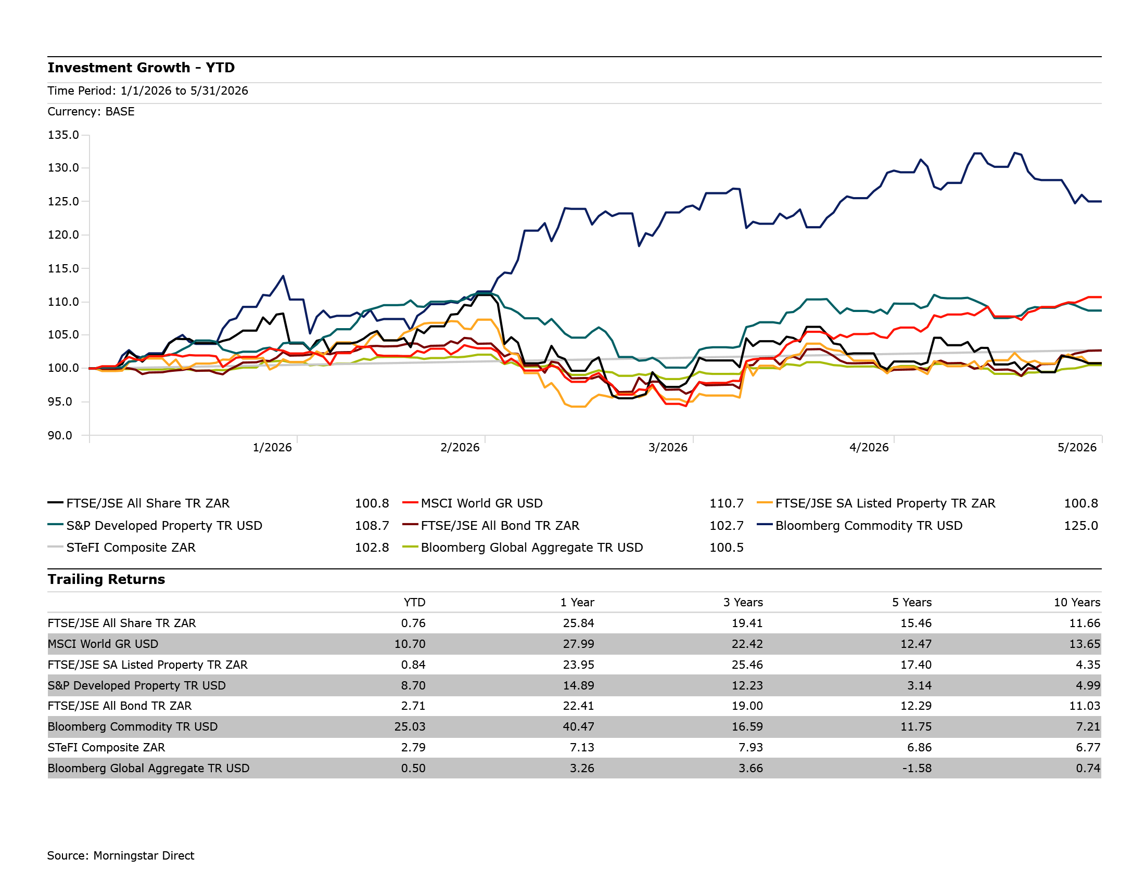
Asset Class Performance (YTD)

Slide 24
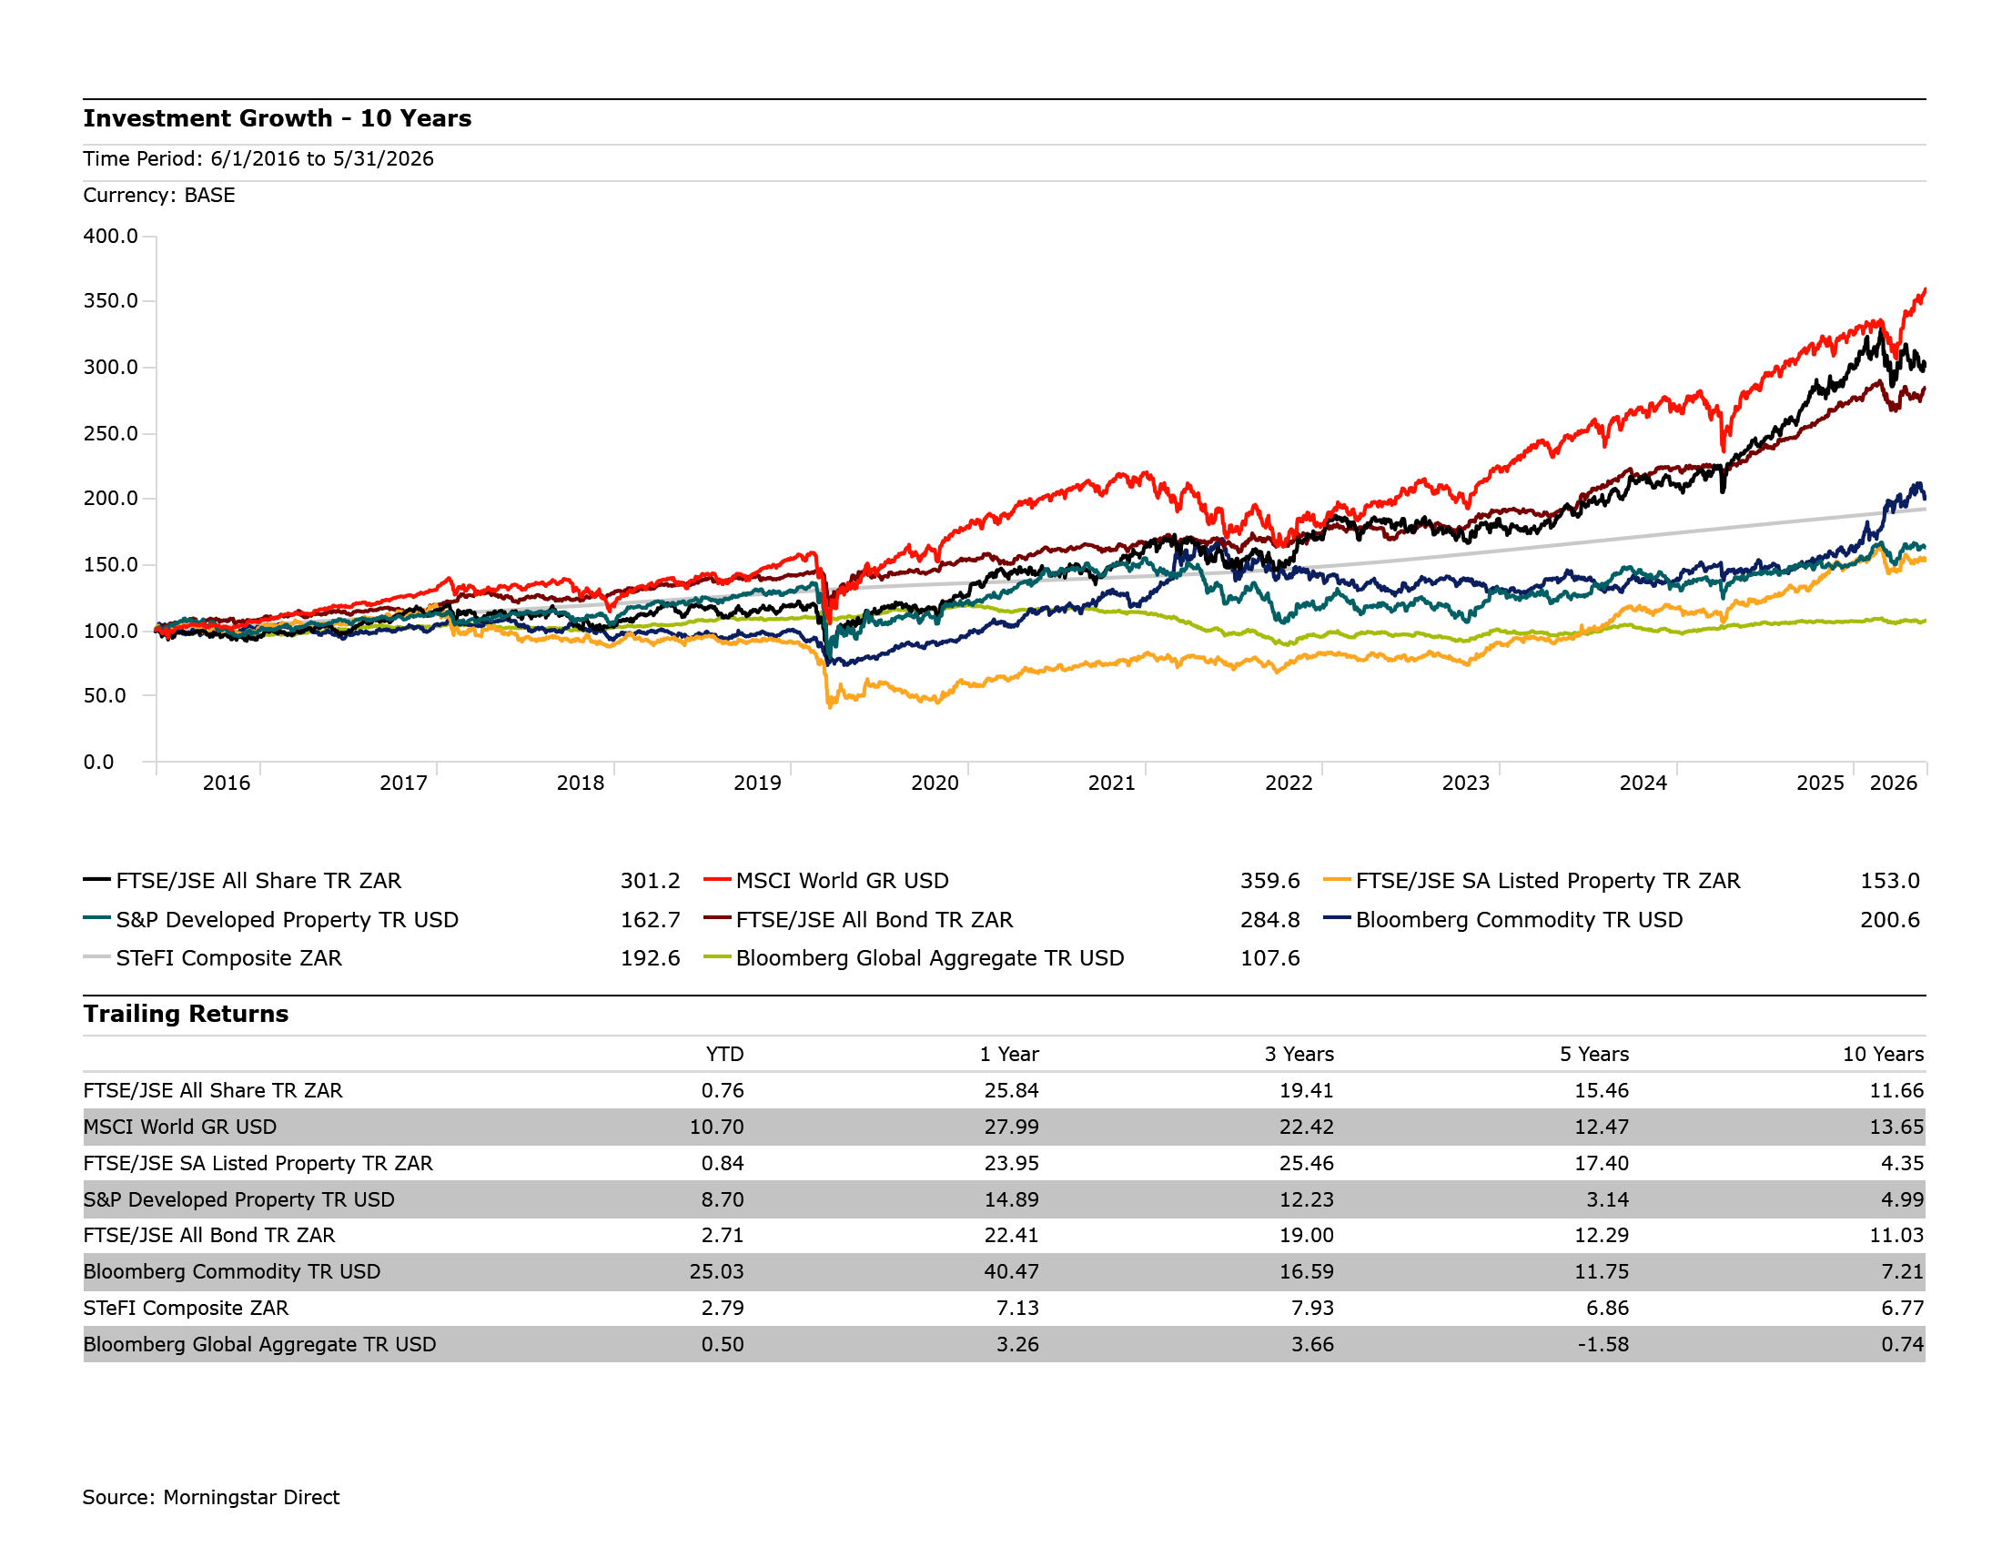
Asset class performance (10 Years)

Slide 25
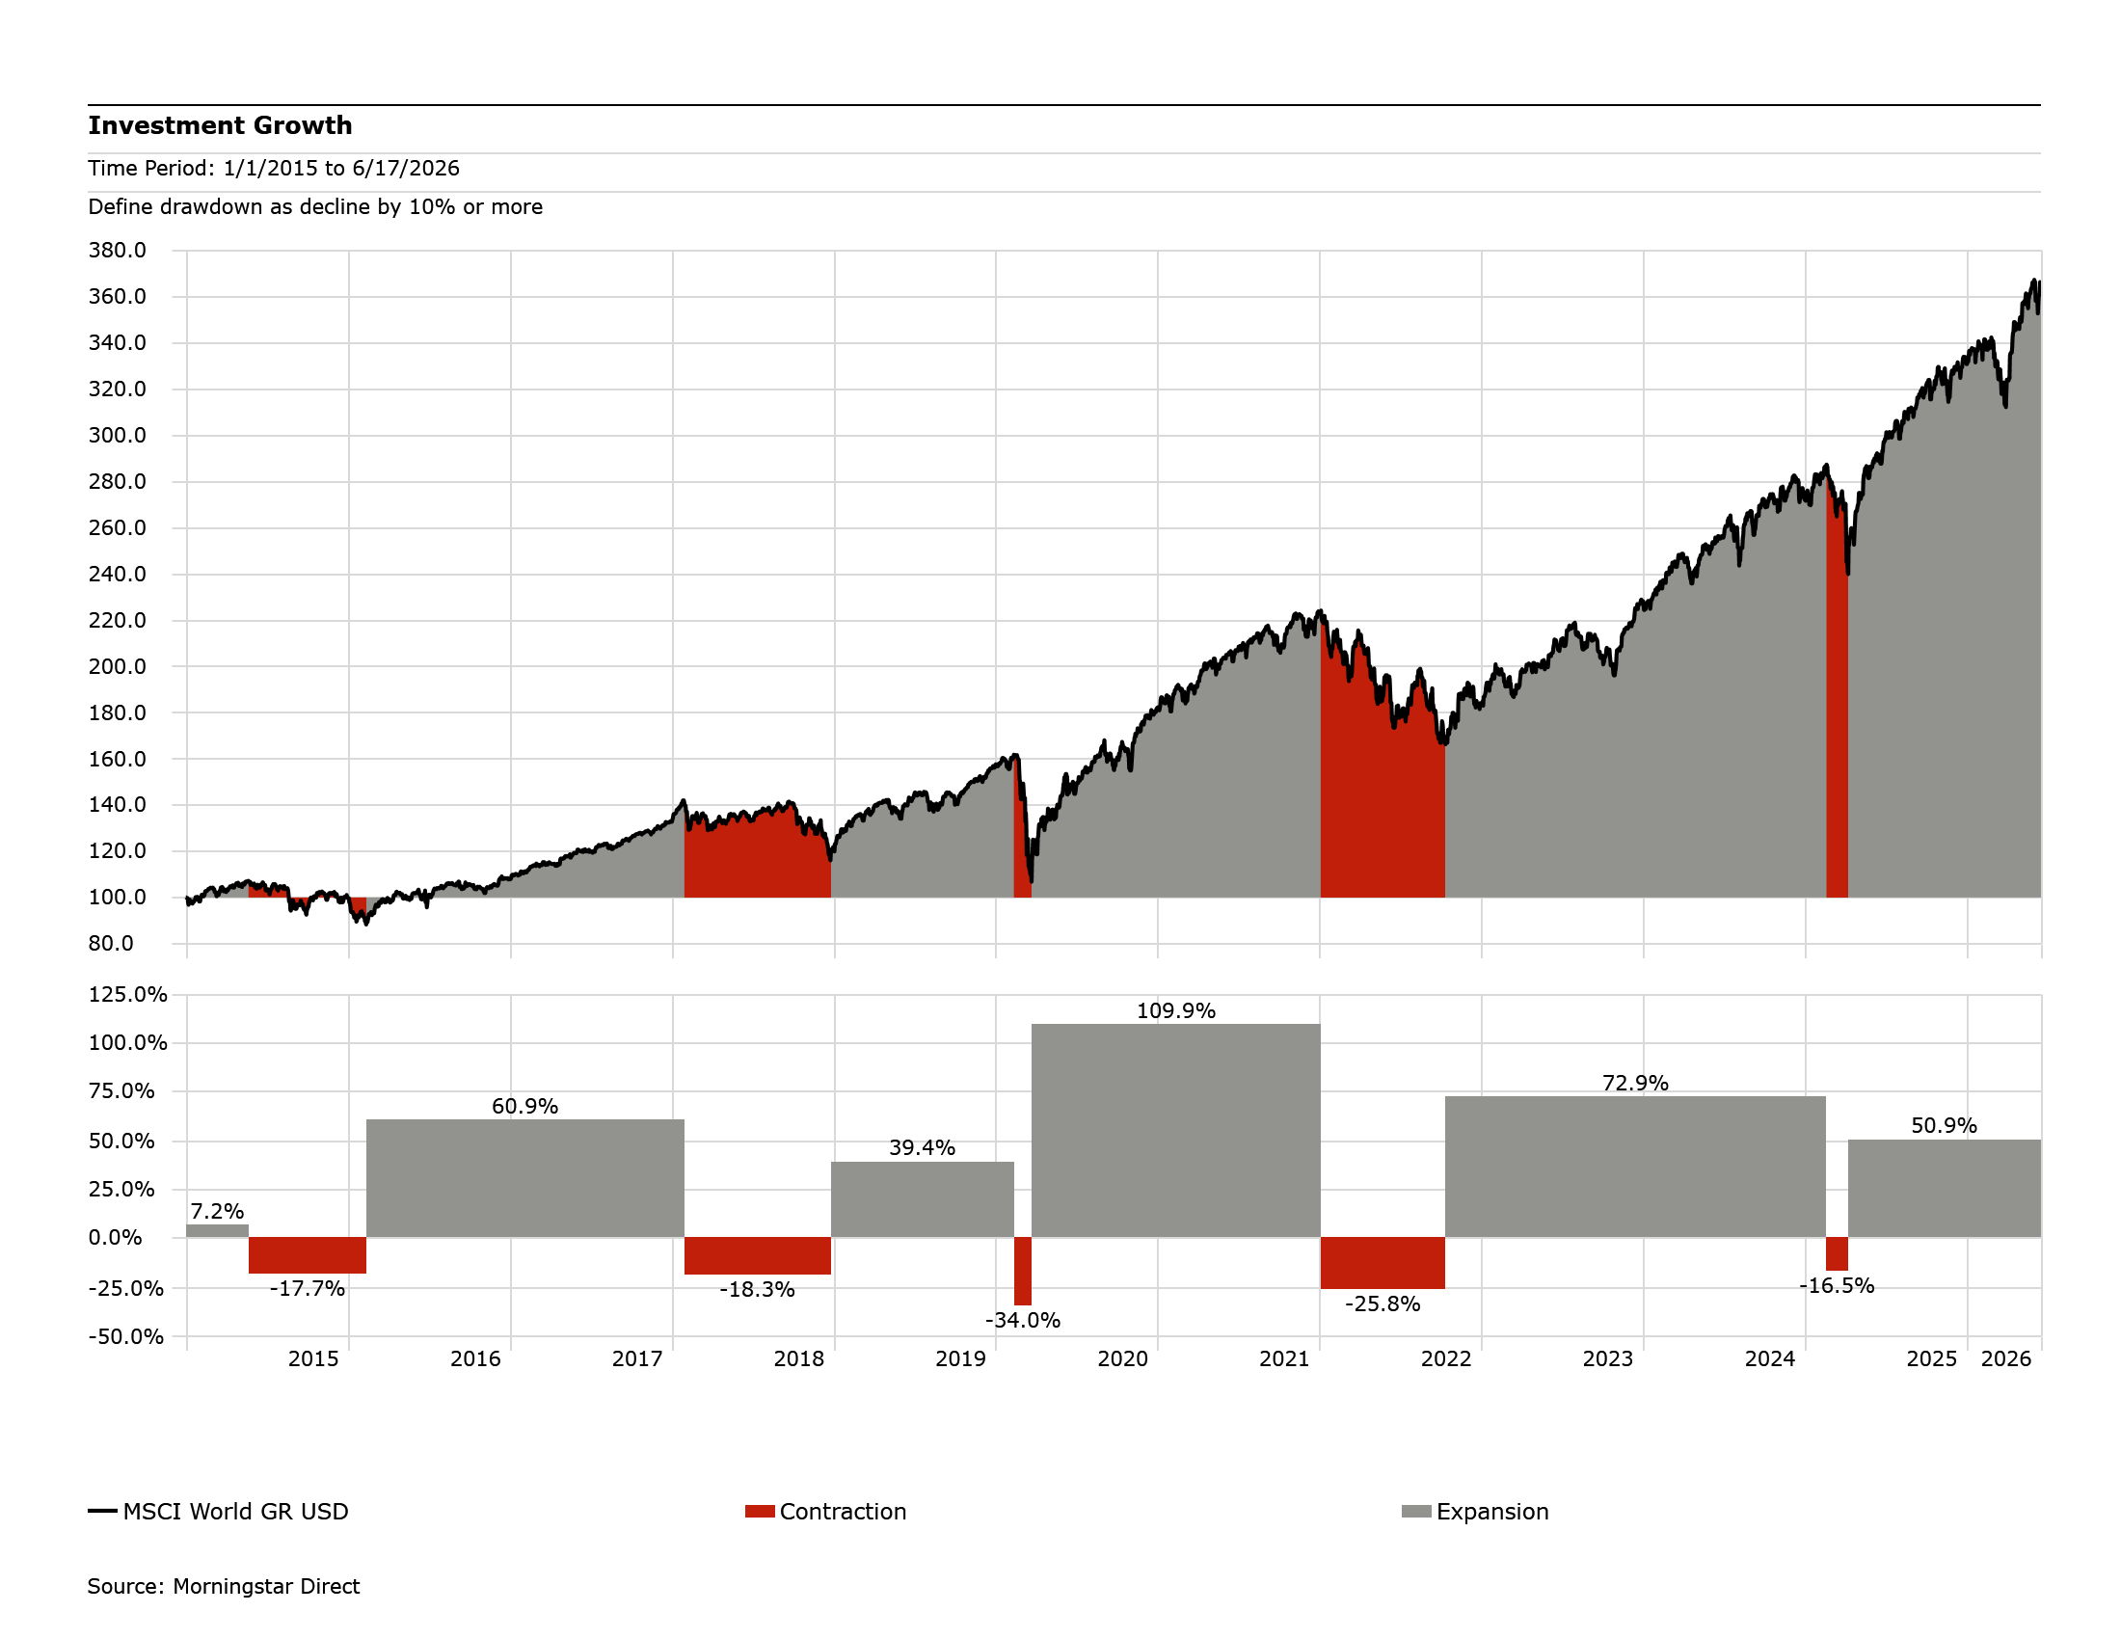
MSCI World Contraction/Expansion

Slide 26
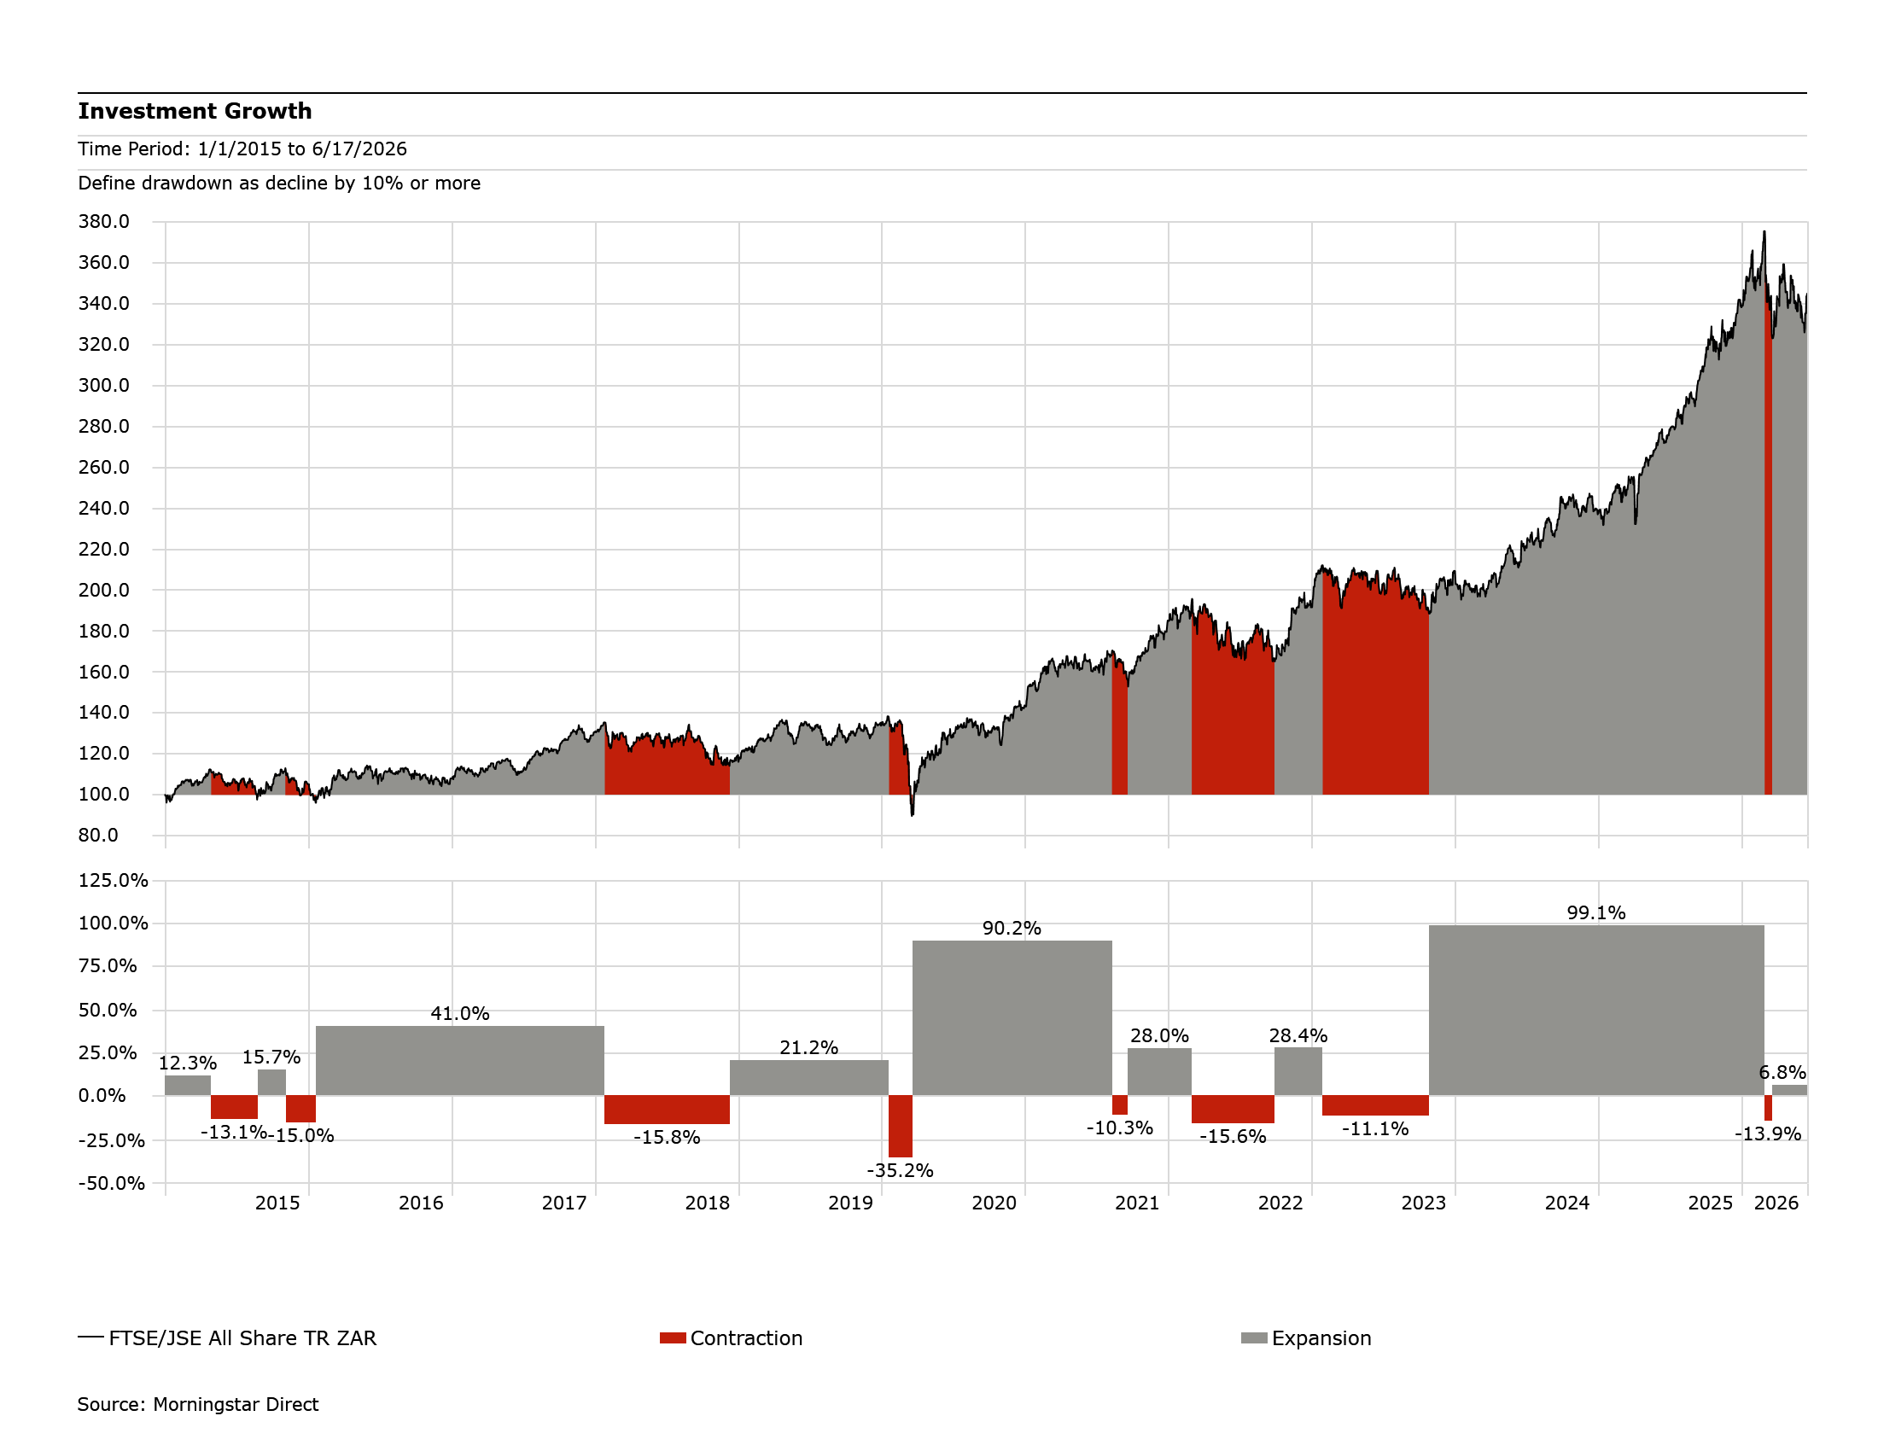
FTSE/JSE All-share Contraction/Expansion

Slide 27
Global Market KPIs
Key
Level | Weak | Moderate | Good
KPI’s | Deteriorating | Stable | Improving | Score
US Inflation |  |  |  | 2 | Moderate and deteriorating
Monetary policy |  |  |  | 3 | Moderate and stable
Consumer spending |  |  |  | 2 | Moderate and stable, but starting to deteriorate
Unemployment |  |  |  | 4 | Good and stable, but starting to deteriorate
Confidence |  |  |  | 2 | Moderate and deteriorating
Economic growth |  |  |  | 3 | Moderate and stable, but starting to deteriorate
Government spending |  |  |  | 4 | Good and stable, but starting to deteriorate
Tax |  |  |  | 3 | Moderate and stable
Global oil prices (inverse) |  |  |  | 2 | Weak and stable, could improve
Geopolitical tension & trade |  |  |  | 1 | Weak and deteriorating
Earnings |  |  |  | 4 | Good and stable, may deteriorate
Valuations |  |  |  | 2 | Weak (stretched) and stable

Slide 28
Local Market KPIs
Key
Level | Weak | Moderate | Good
KPI’s | Deteriorating | Stable | Improving | Score
Inflation |  |  |  | 3 | Good and deteriorating
Monetary policy |  |  |  | 3 | Moderate and stable
Consumer spending |  |  |  | 3 | Moderate and stable
Unemployment |  |  |  | 2 | Weak and stable
Confidence |  |  |  | 3 | Moderate and stable
Energy supply |  |  |  | 4 | Good and stable
Water infrastructure |  |  |  | 2 | Weak and stable, but starting to improve
Logistics (ports, railway) |  |  |  | 4 | Moderate and improving
Geopolitical tension & trade |  |  |  | 1 | Weak and deteriorating
Economic growth |  |  |  | 2 | Weak and stable
Fiscus |  |  |  | 4 | Moderate and improving
Earnings |  |  |  | 4 | Good and stable, may deteriorate
Valuations |  |  |  | 4 | Good and stable

Slide 29
Market Forecasts
 | 2021 | 2022 | 2023 | 2024 | 2025 | 2026 YTD | 20F | 5 Yr. Ann F*
South Africa – ZAR-Denominated
Equities – JSE All Share | 29.2 | 3.6 | 9.3 | 13.4 | 42.4 | 0.76 | 15.1 | 14.4
Alternative alpha – ASISA SA MA Flexible | 22.1 | 0.0 | 11.8 | 13.4 | 20.6 | 2.01 | 10.0 | 9.8
Property – JSE SA Listed Property | 36.9 | 0.6 | 10.2 | 28.9 | 30.6 | 0.84 | 12.4 | 10.3
Bonds – JSE ALBI | 8.4 | 4.2 | 9.7 | 17.2 | 24.2 | 2.71 | 7.1 | 8.5
Alternative beta – ASISA SA MA Low Equity | 13.5 | 1.4 | 11.1 | 12.3 | 15.5 | 0.76 | 7.5 | 8.0
Global Market – Base Currency
Global Equity – MSCI ACWI | 22.4 | -17.7 | 24.4 | 18.0 | 22.9 | 12.35 | 9.6 | 9.5
United States Equity – S&P 500 | 28.7 | -18.1 | 26.3 | 25.0 | 17.9 | 11.72 | 10.7 | 10.9
UK Equity – FTSE 100 | 18.4 | 4.7 | 7.9 | 9.6 | 25.8 | 6.57 | 9.0 | 9.0
European Equity – Euro Stoxx 50 | 24.1 | -8.5 | 23.2 | 11.9 | 22.1 | 6.69 | 9.9 | 9.5
Source: Bloomberg, Morningstar Direct, Absa Investments, January 2026
YTD as at 31 May 2026

Slide 30
Houseview Matrix
Asset Class | Short-term (1-3 years) | Long-term | Rationale
SA Equities | Neutral (+) | Moderately bullish | Local equity markets are attractive from a valuation perspective with earnings poised for a recovery given an improving environment stemming from the containment of the energy crisis, improving logistics, some interest rate cuts, and moderate confidence and spending from both consumers and businesses.
SA Property | Neutral | Moderately bullish | The commercial sector, which is still dominant from a market cap perspective, is not well positioned for the decrease in demand due to work from home shifts. Opportunities are within the smaller localised retail outlets, as well as storage and distribution centres. However, there is not enough opportunities within these sub-sectors to justify higher allocations from an asset class perspective.
SA Bonds | Neutral | Neutral | Bond yields have compressed substantially since the start of the year, spurred by progress on fiscal consolidation efforts, a lowering in the inflation target, rand strength and monetary policy easing. We still maintain an appropriate allocation to local fixed-income securities, particularly in our medium and low risk solutions, due to above-inflation real yields to maturity, attractive coupon rates and alternative systematic risk to equity markets, allowing for diversification. Within this asset class, we advocate for a duration neutral strategy.
SA Cash | Moderately bullish | Bearish | Short-term rates have come down, resulting in more moderate return prospects for cash. We still make use of this asset class to protect from excessive volatility levels and uncertainty in risk asset classes, particularly in our low and medium equity portfolios.
Commodities | Neutral | Bearish | Within this asset class, there are tailwinds in the short- to medium-term for precious metals stemming from elevated geopolitical tensions and central bank purchases. However, in the long-term shifts from industrialisation to consumption-led economic policies, lack of a statistically significant positive drift in commodity prices and excess volatility levels are set to keep the commodity risk premium unattractive for extended time periods.
Global Equities | Neutral | Bullish | Global markets remain resilient despite a volatile environment. The largest risks to global markets are stretched valuations, particularly in the US, heightened geopolitical tensions, as well as increasing trade barriers.
Global Bonds | Neutral | Moderately bearish | Improved valuations on the back of higher interest rates which are around peak levels. Room for yield compression from current levels provides the opportunity for capital appreciation. However, from a rand-optimised perspective, a volatile currency continues to prove challenging from a risk-adjusted basis.
Global Property | Moderately bearish | Neutral | Due to low diversification benefits coupled with structural changes, this asset class remains a tactical call as it carries a high level of systematic risk relative to the developed equity markets.
Source: Absa Investments, April 2026

Slide 31
Local Multi-asset Housesolution Performance
As at 31 May 2026
 | Trailing Return
 | 1 month | YTD | 1 Year | 3 Years | 5 Years
Return Objectives
CPI+5 | 1.6% | 4.6% | 9.2% | 9.2% | 10.2%
CPI+3 | 1.4% | 3.8% | 7.1% | 7.1% | 8.1%
CPI+2 | 1.3% | 3.4% | 6.1% | 6.1% | 7.0%
Peer averages
(ASISA) South African MA High Equity | 0.5% | 2.5% | 15.8% | 13.5% | 11.2%
(ASISA) South African MA Medium Equity | 0.7% | 2.5% | 15.3% | 12.8% | 10.7%
(ASISA) South African MA Low Equity | 0.8% | 2.4% | 13.6% | 12.2% | 10.0%
Passive Funds
ABSA SCI MM Passive Growth E | 1.2% | 4.3% | 19.3% | 16.3% | 14.2%
ABSA SCI MM Passive Accum E | 1.3% | 4.1% | 18.5% | 15.6% | 13.3%
ABSA SCI MM Passive Preserver E | 1.6% | 3.9% | 17.8% | 14.3% | 12.0%
Core Funds
ABSA SCI MM Core Growth C | 0.1% | 2.1% | 14.2% | 12.6% | 11.1%
ABSA SCI MM Core Accumulation C | 0.5% | 1.4% | 13.6% | 12.6% | 10.9%
ABSA SCI MM Core Preserver C | 0.9% | 1.5% | 13.4% | 11.9% | 10.1%
Best Blend Funds
ABSA SCI MM Growth FoF C | -0.1% | 1.7% | 13.7% | 13.3% | 11.4%
ABSA SCI MM Accumulation FoF C | 0.3% | 1.9% | 13.9% | 13.2% | 11.1%
ABSA SCI MM Preserver FoF C | 0.9% | 2.2% | 14.3% | 12.8% | 10.5%
SPM Portfolios
Absa SPM Growth | 0.9% | 1.1% | 10.2% | 11.6% | 10.3%
Absa SPM Accumulation | 0.8% | 1.5% | 11.3% | 11.6% | 9.8%
Absa SPM Preserver | 0.7% | 1.8% | 10.7% | 10.9% | 9.0%
Note: The portfolio return is compared to the return objective and labeled in green if the portfolio return exceeds the return objective or if the portfolio return is lower than the return objective but above the relevant peer average. Returns are labeled in amber if the portfolio return is lower than the return objective and less than 0.5% lower than the peer average. Returns are labeled in red if the portfolio return is lower than the objective and more than 0.5% lower than the peer average return.
Source: Morningstar Direct, Marble, Opus, Absa Investments, May 2026

Slide 32
Global Housesolution Performance
As at 31 May 2026
 | Trailing Return
 | 1 month | YTD | 1 Year | 2 Years | 3 Years | 5 Years
Return Objectives
US CPI+6 | 1.1% | 3.9% | 10.0% | 9.2% | 9.3% | 1.1%
US CPI+5 | 1.0% | 3.6% | 9.0% | 8.2% | 8.3% | 1.0%
US CPI+3 | 0.9% | 3.0% | 6.9% | 6.1% | 6.2% | 0.9%
US CPI+2 | 0.8% | 2.6% | 5.9% | 5.1% | 5.2% | 0.8%
Peer averages
(ASISA) Global EQ General | 4.0% | 6.9% | 22.1% | 16.9% | 17.3% | 4.0%
(ASISA) Global MA High Equity | 3.2% | 5.3% | 19.2% | 15.6% | 14.0% | 3.2%
(ASISA) Global MA Medium Equity | 3.0% | 4.8% | 13.3% | 11.4% | 12.0% | 3.0%
(ASISA) Global MA Low Equity | 1.1% | 2.1% | 9.3% | 9.1% | 8.3% | 1.1%
Single Asset Class Portfolios
Absa SPM Global Equity Note | 5.6% | 5.9% | 20.0% | 16.5% | 17.0% | 5.6%
Multi-asset Portfolios
Absa GDP Growth | 3.2% | 5.7% | 15.4% | 14.0% | 15.1% | 3.2%
Absa GDP Balanced | 2.5% | 4.7% | 12.6% | 11.8% | 12.7% | 2.5%
Absa GDP Cautious | 1.9% | 3.9% | 10.5% | 10.0% | 10.7% | 1.9%
Note: The portfolio return is compared to the return objective and labeled in green if the portfolio return exceeds the return objective or if the portfolio return is lower than the return objective but above the relevant peer average. Returns are labeled in amber if the portfolio return is lower than the return objective and less than 0.5% lower than the peer average. Returns are labeled in red if the portfolio return is lower than the objective and more than 0.5% lower than the peer average return.
US CPI values are as at 30 April 2026
Source: Morningstar Direct, Marble, Opus, Absa Investments, May 2026

Slide 33
Disclaimer
Absa is an Authorised Financial Services Provider FSP523 Registered Credit Provider Reg No NCRCP7
The information contained in this communication from the sender is confidential. It is intended solely for use by the recipient and others authorised to receive it. If you are not the recipient, you are hereby notified that any disclosure, copying, distribution or taking action in relation of the contents of this information is strictly prohibited and may be unlawful. This commentary is for information purposes only and you must not regard this as a prospectus for any security or financial product or transaction. Absa does not expressly, tacitly or by implication represent, recommend or propose that the securities and/or financial or investment products or services (the “Products”) referred to in this commentary are appropriate and/or suitable for your particular investment objectives or financial situation or needs. This commentary is not, nor is it intended to be, advice as defined and/or contemplated in Financial Advisory and Intermediary Services Act, 37 of 2002 (“FAIS”), or any other financial, investment, trading, tax, legal, accounting, retirement, actuarial or other professional advice or service whatsoever (“advice”). All the risks and significant issues related to or associated with the Products are not disclosed and therefore, prior to investing or transacting, you should fully understand the Products and any risks and significant issues related to or associated with them. This commentary is neither an offer to sell nor a solicitation of an offer to buy any of the Products, which shall always be subject to Absa’s internal approvals and the execution of all requisite documentation between you and Absa. You have to obtain your own advice prior to making any decision or taking any action based hereon and neither Absa, nor any affiliate, nor any of their respective officers, directors, partners, or employees (in whose favor this constitutes a stipulation on behalf of another) accepts any liability whatsoever for any direct, indirect or consequential damages or loss arising from any use of or reliance on this publication or its contents, and irrespective of whether or not you have obtained independent advice. Any and all forecasts, illustrations, hypothetical data and/or expectations used and/or referred to herein, are not guaranteed but merely provided for illustrative and demonstrative purposes only.
Important restrictions, qualifications and disclaimers that further apply to this content available at www.absa.co.za/disclaimers.

