Slide 1
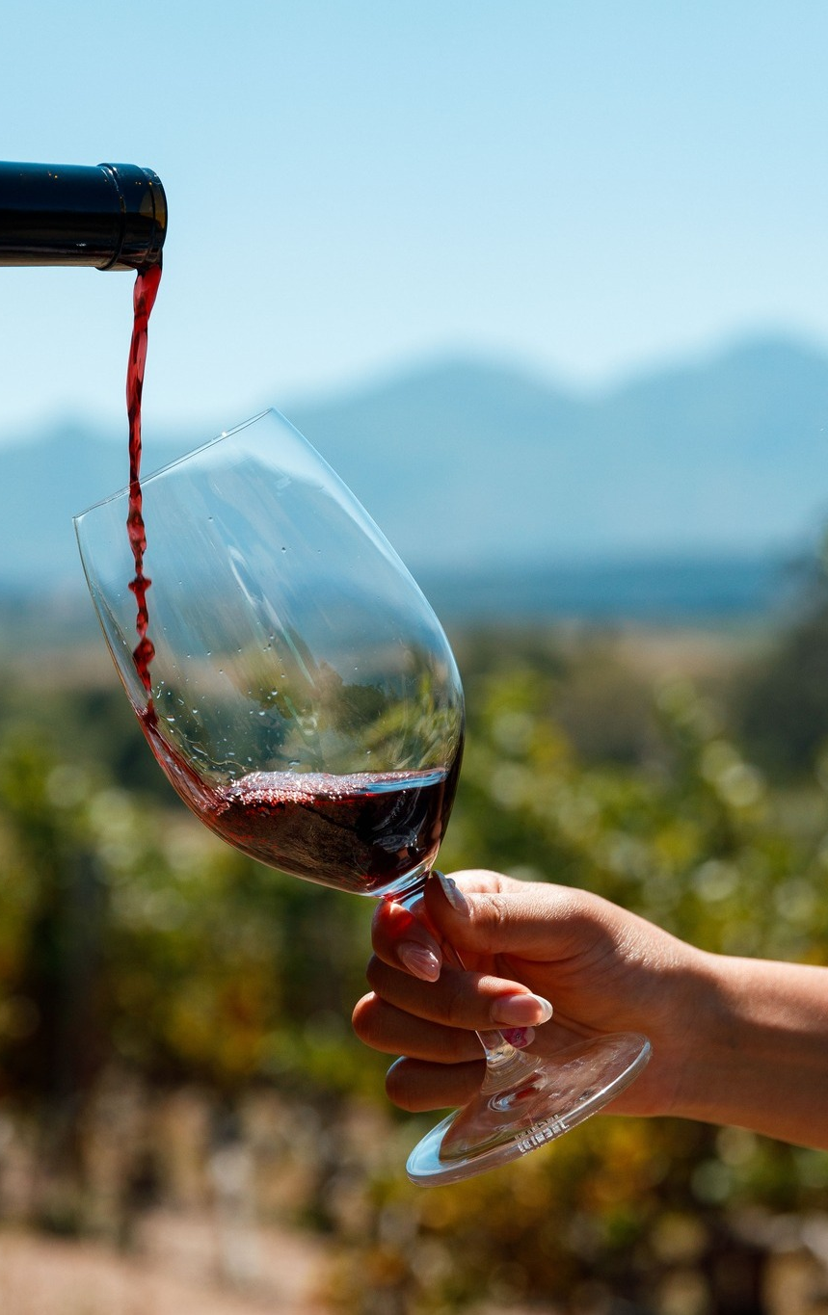

The role of media in the wine industry
Suzaan Potgieter
Die Burger Versnit

Slide 2
What we give and what you need
Media:
Platform
Audience
Exposure
Wine industry:
Marketing
Audience
Reliability

Slide 3

Yes, you can!

Slide 4


But can you offer this?
A trusted and reliable source.
Information shared from someone not involved.
An audience that is guaranteed to love wine.
Narratives and not just advertising.
A variety of platforms.

Slide 5
Quote
Audience (and age) matters

Slide 6
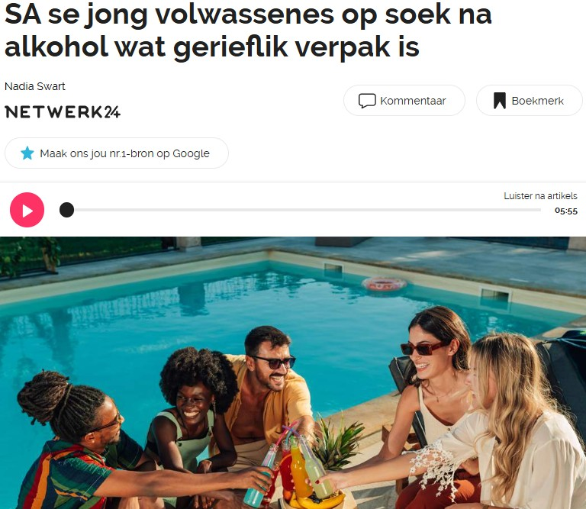
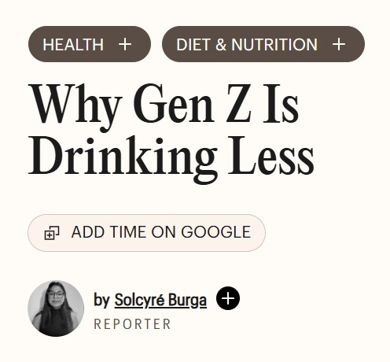


Slide 7
Looking at the numbers
Die Burger average reader: Mid-40s
Netwerk24: 23% of readers are 25-34
News24: 24% of readers are 35-44
Gen Z: 14-29 years old

Slide 8
A World Finance report shows that Gen Z’s drink, on average,
20% less than millennials.
20%

Slide 9
It's fine! We can work with that
We give readers what they want:
The media focuses on an older audience that still enjoys drinking alcohol, specifically wine.
Online wine content performs: Netwerk24 WYN is 7.63% of total users but accounts for a remarkable 42.22% of all sessions and News24 WINE represents 4.55% of total users but drives a hefty 22.42% of all sessions.
Die Burger has a very engaging wine audience who look forward to our content.
This does not mean we do not focus on Gen Z:
This is where educational articles come into play.
We share articles about the drinks they are interested in.
We also share advice with wineries about this new generation of drinkers.
They don’t want to read, but we offer more than just reading.

Slide 10
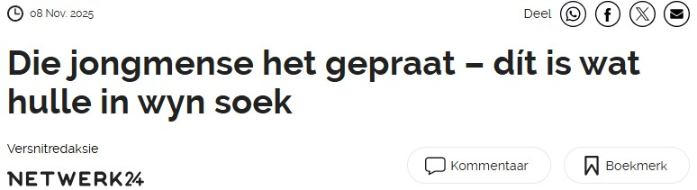
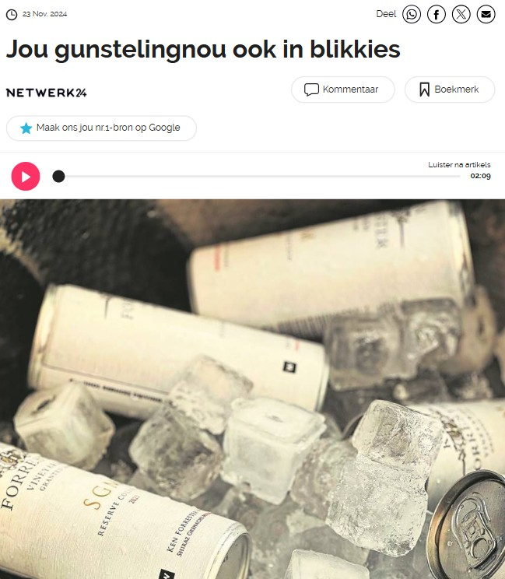
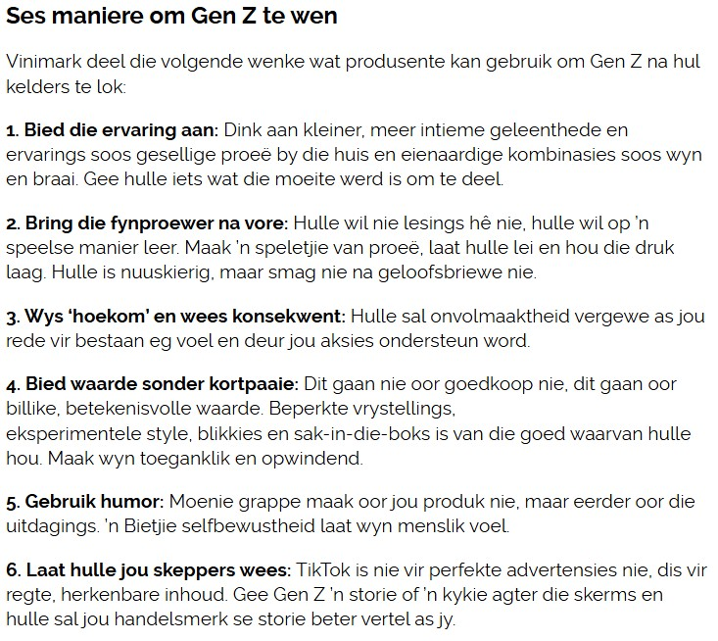

Slide 11
Print is not dead. We have, however, evolved into something better

Slide 12
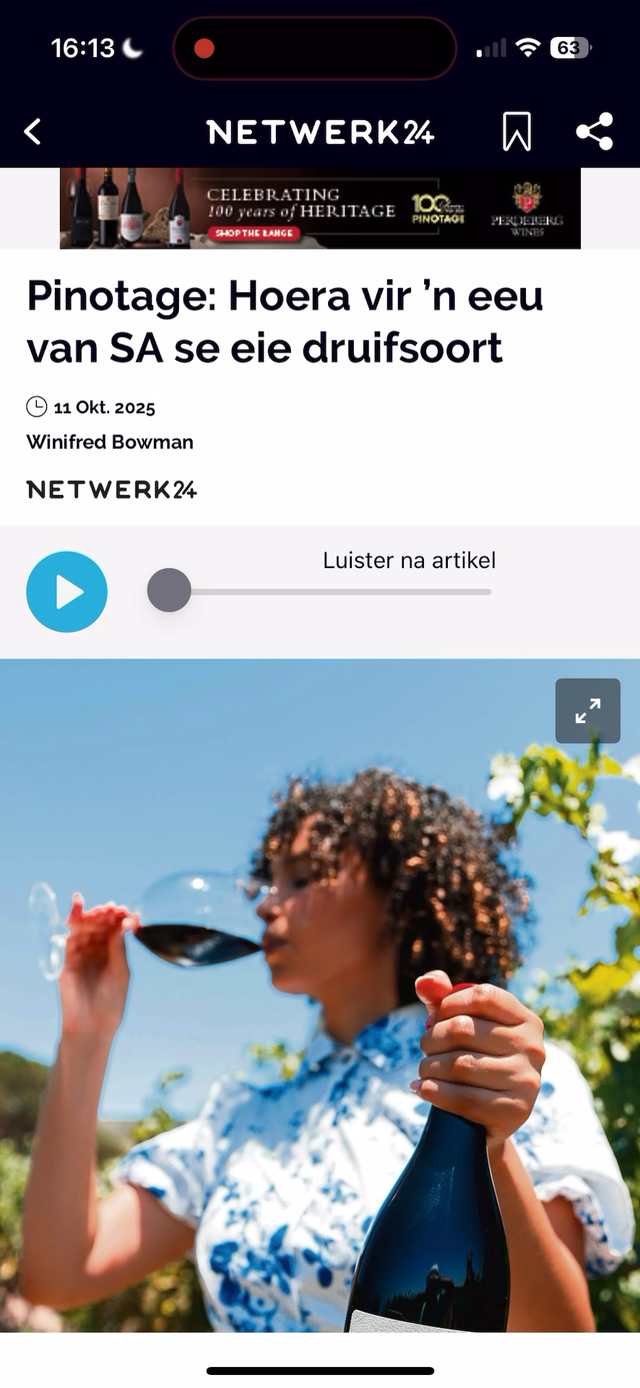
No time to read? Then listen!

Slide 13


How print has changed
Everything is also available online
Articles in print appear online and are available to a much bigger audience, including people from other provinces and countries.
Different formats
Articles are no longer the only form of journalism. There are podcasts, videos, you can listen to articles, and we package information into infographics.
Special projects
We have a yearly wine route magazine and special projects. If you can imagine it, we can create it!

Slide 14
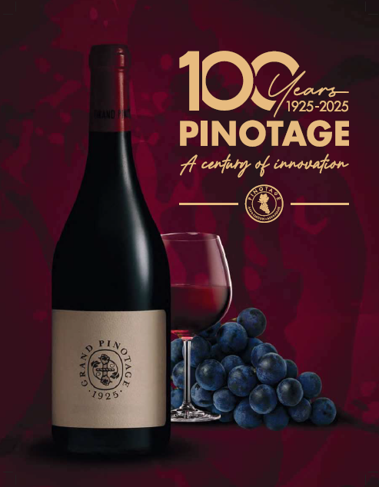
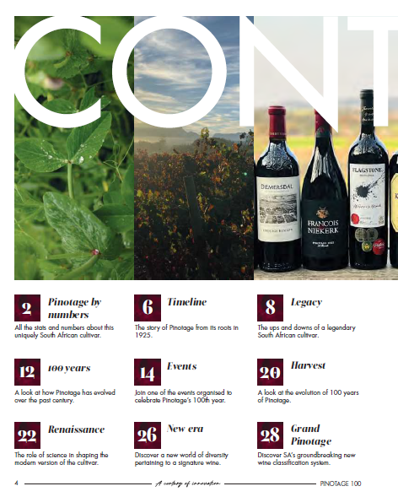
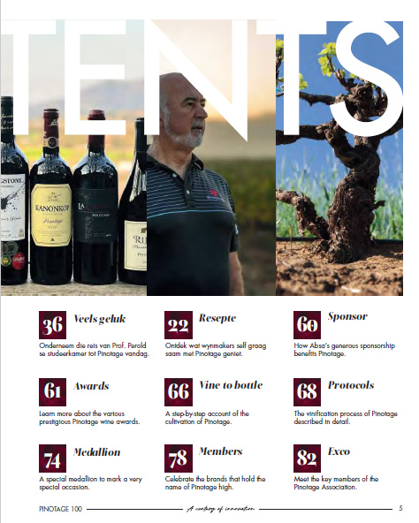
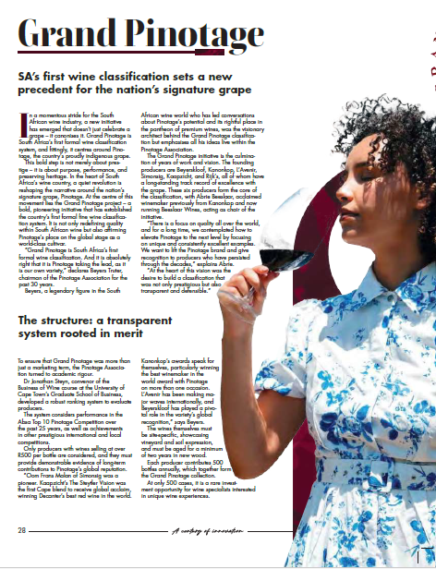
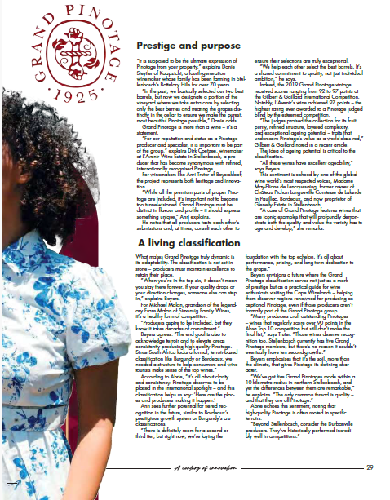
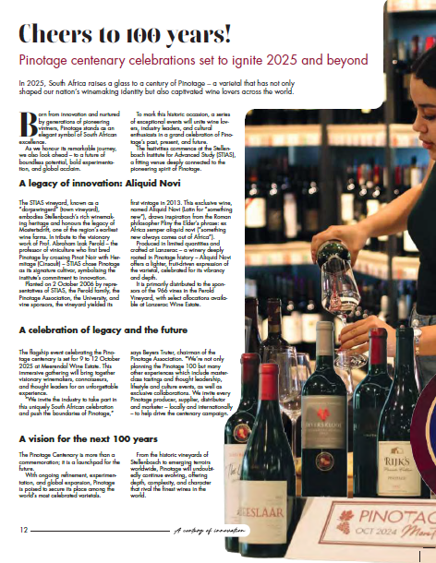
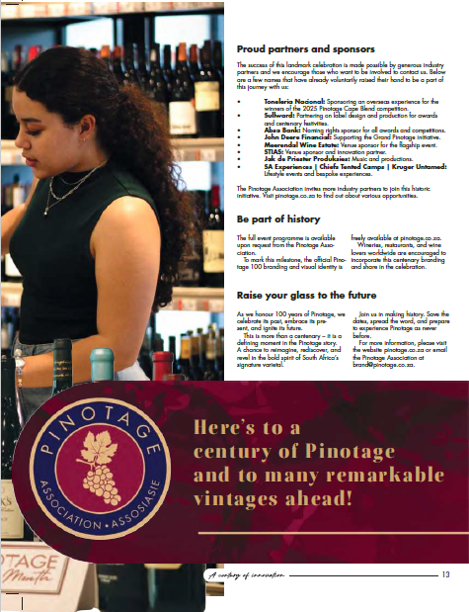
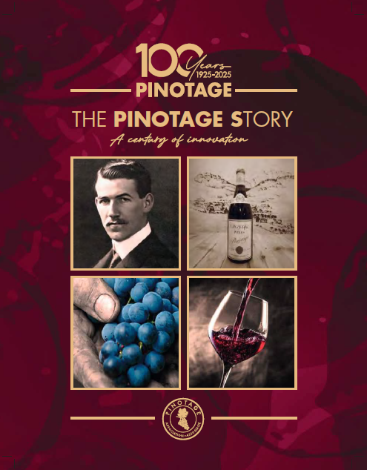
Projects: Pinotage 100

Slide 15


Thank you!

